Slide 1
Market-Led Urbanism and Geographic Crises:
A Micro-Simulation Lens on Beirut
Ali Termos
Finance group, American University in Bulgaria
Bulgaria; E-Mail: atermos@aubg.edu
Neil Yorke-Smith
Algorithmics group, Delft University of Technology
Netherlands; E-Mail: n.yorke-smith@tudelft.nl

Slide 2
Highlights and Assumptions
Challenges to using agent-based models (ABM) in urban studies
Integrating econometric modelling with ABMs
The importance of GIS and GPS data in simulations (geographic information system mapping) and OpenStreetMap.
Rent-Gap theory
Urban impact of refugee's influx into a city
In our ABM, agents represent households. Each household lives at a location in the city, which represents a residential dwelling. The agents seek to move if their income permits, if their current dwelling is too poor in maintenance, or if the cognitive dissonance with their neighbors is too great. Locations decline in maintenance level in time, and can be repaired or redeveloped.

Slide 3
Agent-based Models
An agent is “a representation of a decision-making entity in the real world, be it an individual or an organisation” Van Dam et al. (2013)
Agent-based modelling (ABM) is “a paradigm for simulating the actions and interactions of autonomous heterogeneous agents, which do not need to be perfectly rational or perfectly informed, in order to study the emergent system-level effects of collective agents’ behaviour within a certain environment, over time” (Chappin et al., 2019).
“Agent-based models are constructed to discover possible emergent properties from a bottom-up perspective. They attempt to replicate, in silico, certain concepts, actions, relations or mechanisms that are proposed to exist in the real-world, in order to see what happens.” Van Dam et al. (2013)

Slide 4
Literature
Picascia (2015) and Picascia & Yorke-Smith (2017): rent-gap theory and gentrification using agent-based simulations applied to European cities.
Ge (2013): Agent-based spatial model on U.S. housing market.
Zhang & Li (2014): applied ABM on a buyer and seller search behavior in the housing market in Beijing.
Collins & Frydenlund (2016): refugees
Goren (2016): conflict in Mali
Suleimenova, Bell, & Goren (2017): conflict in Africa
Hebert, Perez, & Harati: conflict in Syria
Hatton (2017): migration into Europe

Slide 5
Why Beirut?
Limited affordable housing
Complex political and socioeconomic systems
Weak public institutions (regulations are rarely enforced)
Unstable geo-political environment
Exceptionally high number of refugees (nearly 50%!)
Dire Economic and financial crisis (October 2019)
Devastating explosion of the port of Beirut (August 2020)
High dependency on imports
Neo-liberal real estate market (high income inequality)

Slide 6


Slide 7
The Beirut metropolitan area and its quartiers

Slide 8
Housing price index

Slide 11
Parameters of the model - I

Slide 12
Parameters of the model - II

Slide 13
The simulation

Slide 14
Variables associated with the Agent:

Slide 20
Extension of the baseline model
We make the following modifications to the above ‘baseline’ model:
•Extending the geographic range from the strict boundaries of the municipality to a large portion of peri-urban Beirut. This is important because of the urban sprawl and population percentage outside the municipal boundary.
•Including the building density per district. This is important because residential options are not uniform between districts.
• Three cases: by calibrating on housing price and population data for the point in time, and removing refugees’ influx if prior to the Syrian War: Hariri Assassination (2005) and Israel-Lebanon war (2006); Syrian war (2011) and Port explosion and economic collapse (2020).

Slide 21
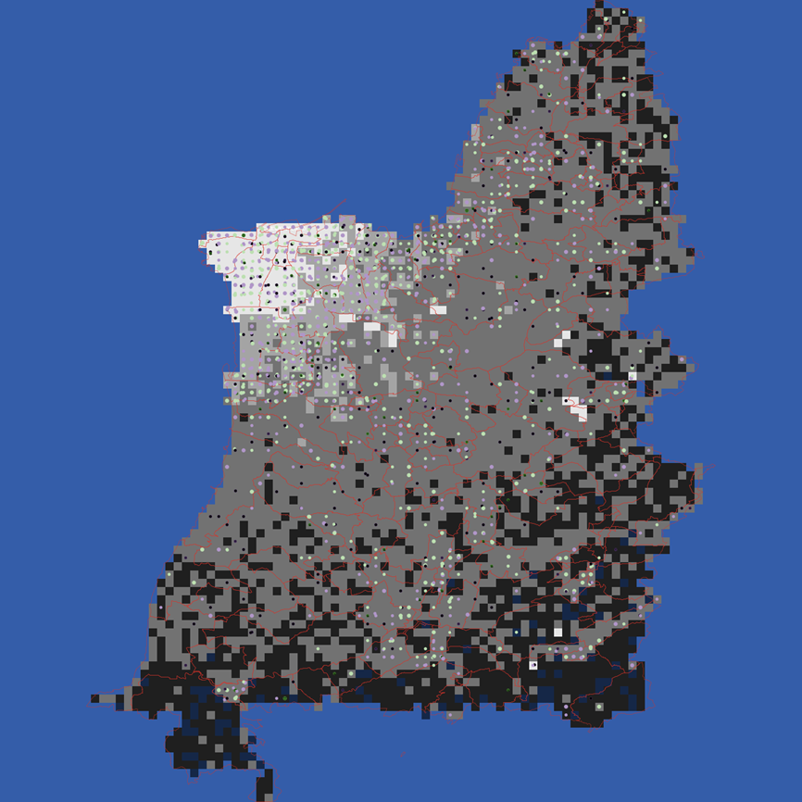
A visualisation of the ABM is seen here. The model is implemented in the dedicated ABM language NetLogo (Wilensky, 1999), version 6.2. The base model is available at: www.doi.org/10.4121/13033154.
Geographic visualisation of the Greater Beirut region captured in the simulation. Municipal Beirut is seen top left; the Mediterranean Sea borders the west and north. Squares are coloured by the maintenance level of the properties (brighter = better condition). Household agents are depicted by circles; colour denotes income category. District boundaries are shown by red lines.

Slide 22
New Data to be obtained
In order to calibrate the simulation, six items of data are required: geo-physical, demographics, building density, housing prices, property conditions, and (particularly after 2011) refugee population.
Population Density:
First, we identified our target localities using GIS data. Then we matched the coordinates of these target 223 districts with those of the GIS data and computed population in each district, in addition to population of the five nearest points to each district. We then traced population growth for the periods of the events under study, these are 2005, 2011 and 2020.

Slide 23
Housing Price
To capture the variation in housing price for each district we included additional variable to the previous econometric model: the distance from each district to downtown Beirut. The econometric model now includes interest rate, building permits, construction cost, in addition to distance. We use the inverse distance for a direct interpretation of the results.
Building Density and Maintenance Level
We constructed building density by regressing building permits over population and distance from the Beirut Central District (BCD). To compute the maintenance level in 2005 we used a survey from 2017 that was based on expert opinion. Based on that survey we created an instrumental variable by regressing the survey data on house price, population, and distance from BCD . Then we used the regression line to estimate the maintenance levels in 2011 and 2020.

Slide 24
We study the impact on housing and household mobility for eight years after 2005: one scenario as if the 2005 and 2006 events did not occur (baseline scenario) and one if they did.

Slide 25
We ran the simulation from a start date of January 2019, for a period of 10 simulated years. In the shorter term, the effect on the city and its residents can be seen (Figure 4). In the longer term, assuming sufficient capital in the economy, the regeneration process means that residents can move back (Figure 5). Note the greater population and population density in the no-explosion scenario.

Slide 28
Conclusion
The contributions of the study:
We illustrate the feasibility of a data-driven quantitative-qualitative individual-level simulation, a methodological approach complementary to and triangulating with other methodologies such as equation-based quantisation and literature-based enquiry. Further, by using the ABM for ‘what-if’ analysis and for understanding emergent urban outcomes, planners, policy makers and humanitarian organisations have a tool to help in responding to shocks upon the urban environment.
We examine a rich vein of macro-economic data analytics that can further inform and complement the ABM: for instance, how Lebanese banks developed non-cash agility in the mortgage market in order to clear out housing supply during the currency crises. This would complement purely econometric analysis of the property market with behavioural aspects from household residential mobility decisions.

